Slide 1
NYC Taxi Data Platform
How does adverse weather affect taxi demand across New York City, and how have those patterns changed over time?
Team AMO: Ariana Lopez, Maryam Choudhury, Orlando Marin
Notes:
ORLANDO: Good morning, everyone, thank you for being here. I'm Orlando, joined by Ariana and Maryam, and we're going to answer the question: how does adverse weather affect taxi demand across New York City, and have those patterns changed over time?

Slide 2
Topics of Discussion
1
The Business Question and Key Finding
2
Data and Architecture
3
Our Findings
4
Future State
Notes:
ORLANDO: I'll open with a breakdown of our business question and our key findings. Ariana and Maryam will walk through the data and pipeline architecture, as well as additional paths that we explored. We'll share the YoY analysis that supports our findings, and then we'll close by sharing a few things we'd implement with more time. We look forward to answering your questions afterward.

Slide 3
1
The Business Question and Key Finding
Notes:
ORLANDO: Let's start with what we set out to answer, and our key findings.

Slide 4
The Business Question
How Does Adverse Weather Influence Taxi Demand, and Have Those Patterns Changed Over Time?
Comparison of January-May 2025 and January-May 2026
Why This Matters
🚕 Operations
Anticipate demand changes during poor weather
💰 Business Decisions
Understand where weather has the greatest impact
🏙️ City Planning
Support transportation planning across boroughs
Scope
🚕 Yellow + Green taxi, Jan-May 2025 vs Jan-May 2026
📊 39.2 million trip records
🌦️ 7,248 hours of NYC weather conditions
🗺️ 265 taxi zones mapped to 5 boroughs
🌧️ Adverse weather = rain and snow
How We Measured Impact
We combined hourly weather conditions with taxi activity and compared the same months across both years to ensure a fair comparison.
Notes:
ORLANDO: The business question that we set out to answer is "how does adverse weather (which includes rain and snow) impact taxi demand, and has that relationship changed year over year?" We scoped this to January through May in both 2025 and 2026 to ensure a fair YoY comparison. We combined over 39 million trip records with about 7,250 hours of weather data, so every trip is paired with the exact weather conditions at the time of pickup. This matters for operations, business decisions, and city planning.

Slide 5
Headline Finding
Weather doesn't change what a ride costs. It changes how many rides happen, and that impact is concentrated in the hours and boroughs that matter most.
38M+
Trip Records Analyzed
10 months
Jan-May 2025 vs 2026
5 boroughs
Weather Impact Compared
Business Insight
During rain, prioritize Brooklyn where demand and earnings both surge. During snow, per-minute earnings rise 8-29% across all boroughs. During clear weather, choose Manhattan for volume or Queens for higher per-trip returns.
Notes:
ORLANDO: Here's the headline from our analysis. Adverse weather doesn't change what a ride costs. Fares stay essentially flat across all boroughs regardless of conditions. What changes is how many rides happen, and that impact is not spread evenly. It concentrates in specific boroughs and specific hours. We analyzed over 38 million trips across 10 months and all five boroughs. The key insight is that each weather condition creates a different positioning opportunity. During rain, Brooklyn demand surges 27 percent and per-minute earnings rise 11 percent. During snow, per-minute earnings rise in every borough, from 8 percent in Manhattan to 29 percent in the Bronx. And during clear weather, which is 94.5 percent of all hours, drivers choose between Manhattan's unmatched volume or Queens' 14 percent per-minute premium on longer trips. The bottom line: weather creates positioning opportunities, not just risk.

Slide 6
2
Data and Architecture
Notes:
ORLANDO: With that context in mind, I'll pass it to Maryam and Ariana, and they'll walk through the data and our pipeline architecture.

Slide 7
The Data
What We Were Given
• 20 Parquet files in S3
• Yellow: 38.8M rows
• Green: 465K rows
• Jan-May 2025 & 2026
• 265 taxi zones
What We Added
Open-Meteo Historical Weather API
7,248 hourly records
Temperature
Snow
Rain
Preciptation
Weather description
Wind
Schema Challenges
Different timestamp fields
Green-only fields
Case-sensitive inferred columns
39,224,735
Total Trip Records
7,248
Weather Hours
265
Taxi Zones
Notes:
MARYAM: Before we get into the platform we built, I want to briefly go through and explain the data.
Our primary dataset consists of New York City taxi trips, where each record represents a single ride from pickup to dropoff.
We worked with both Yellow Taxi and Green Taxi data.
Yellow taxis operate throughout the city and make up the vast majority of the dataset, while Green taxis primarily serve areas outside of Manhattan's central business districts.
In total, the raw data included approximately 38.8 million Yellow Taxi trips and 465,000 Green Taxi trips spanning January through May of 2025 and 2026.
We mapped 265 taxi zones across the city.
As an external data source, we incorporated hourly weather data. This allowed us to connect weather patterns directly to taxi activity.
There were some schema challenges with the data, we will go more into detail on that later on.
After combining everything, our final dataset included more than 39 million taxi trips, 7,200+ hourly weather records, and all 265 taxi zones, giving us a strong foundation for analysis.

Slide 8
Data Quality Findings
Data Quality Findings
Null/zero passenger count: 9.2M (23%) → Retained (warning)
Payment type 0 (undocumented): 9M (23%) → Retained (warning)
Invalid timestamps: 702K (1.8%) → Flagged invalid
Negative fares: 247K (0.6%) → Flagged invalid
Distance > 100 miles: 131K (0.3%) → Flagged invalid
Dropoff before pickup: 87K (0.2%) → Flagged invalid
Pipeline Reconciliation
The Cash Tip Trap
Cash tips are not captured in the dataset because tip amounts are only recorded for credit card transactions.
To ensure accurate reporting, cash tips were excluded from all total revenue calculations.
Stage | Rows
Source Files | 39,224,735
Bronze | 39,224,735
Silver | 39,224,735
Gold (Valid Only) | 38,053,445
Our Approach: Flag, Don't Delete
Instead of immediately removing questionable records, we added two fields:
is_valid: indicates whether a trip passed validation
dq_flag_reason: records why a trip failed
Silver retains all records for transparency and future analysis, while Gold contains only validated records used for reporting.
This preserves traceability and allows future analysis of data quality trends.
Notes:
MARYAM: Before we could trust any insights, we needed to trust the data itself.
Although all 39.2 million records loaded successfully, we found several quality issues that affected about 3% of trips.
Rather than deleting those records, we adopted a "flag, don't delete" approach.
We flagged each record with data quality indicators and preserved the original data.
This gave us reliable reporting based on validated trips without losing the underlying records.
We also identified that the dataset only records tips paid by credit card, and cash tips appear as zero.
To avoid misleading results, we excluded cash tips from all tip and total revenue calculations.
After our findings, we were left with 38 million records to do analysis on.
I'm going to pass it on to Ariana to go over our architecture.

Slide 9
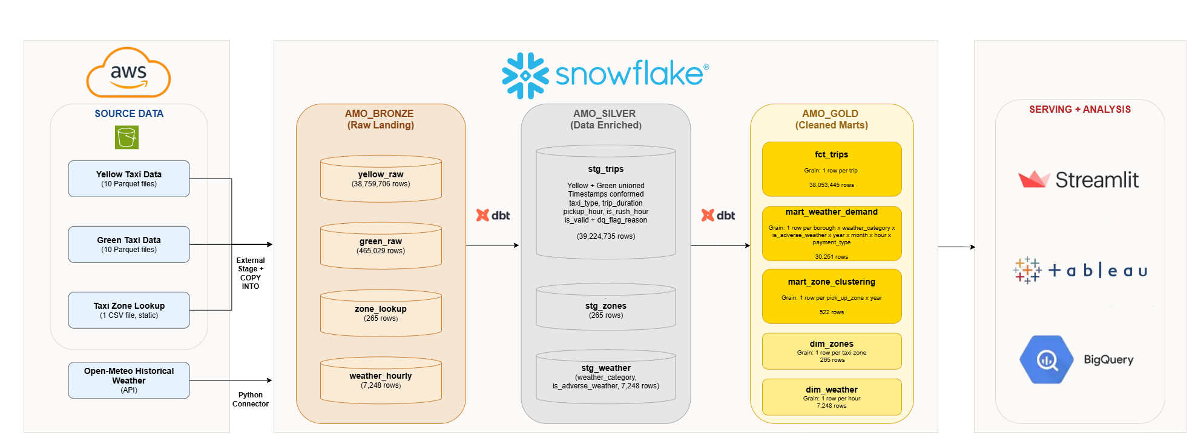
Pipeline Architecture
Current Performance: Full pipeline rebuild in ~6 minutes, with dashboard queries returning results in under 1 second.
Scalability: Architecture can support 10x growth through Snowpipe ingestion, incremental dbt models, and Snowflake warehouse scaling without a redesign.
Notes:
This diagram shows how data moves through our platform, moving from left to right, with raw taxi and weather sources on the left and our end user platforms on the right.
Starting on the left with our source datasets. This data includes Yellow Taxi trips, Green Taxi trips, taxi zone information, and historical weather data. These datasets are loaded into Snowflake, which serves as the central platform for storage and transformation.
We organize the data using a Medallion Architecture with Bronze, Silver, and Gold layers.
The Bronze layer stores the raw source data exactly as received, providing a complete audit trail and preserving the original records.
The Silver layer is where data is standardized, combined, and enriched. Here we merge the taxi datasets, add weather and time-based attributes, and perform data quality checks. Instead of immediately deleting invalid records, we flag them so data quality can be monitored and investigated over time.
The Gold layer contains trusted, business-ready datasets. Only validated records are present here, ensuring that reporting and analysis are based on reliable information.
All transformations between the Bronze, Silver, and Gold layers are managed through dbt, which applies business rules consistently and makes the pipeline repeatable and maintainable.
Finally, tools such as Tableau, Streamlit, and BigQuery connect to the Gold layer, allowing users to explore trends, answer business questions, and make data-driven decisions.
This architecture is also designed to scale as data volumes grow. Instead of loading data in large scheduled batches, further fimplementation of Snowpipe would automatically load new data as it arrives, reducing delays and keeping information more up to date.
Combined with incremental dbt processing and Snowflake's ability to add computing power on demand, the platform can support significantly larger volumes of data without requiring a full redesign further in the future.

Slide 10
Architecture Decision: Snowflake + DBT
Why We Chose This Approach
Our team has the strongest experience with SQL, allowing us to move quickly and confidently.
The architecture had the fewest moving parts, making it the best fit for a one-week sprint
All transformation logic was tested, version-controlled, and maintainable through dbt
Snowflake efficiently processed our 39 million records without acquiring additional distributed computing tools
End-to-end pipeline execution completed in approximately 6 minutes, enabling rapid development and testing
Key Design Decisions
Materialized staging tables instead of views to avoid repeatedly processing 39 million records during dashboard queries
Data quality filtering implemented through an is_valid = True flag, ensuring only trusted records reached the Gold layer
Weather data joined at the hour level, matching taxi trip timestamp granularity and achieving a 100% join match rate
Centralized orchestration approach, where a single command executes the entire pipeline, supports repeatability, fast failure detection, and simplified operations
Speed, Trust, Simplicity
Notes:
We designed our solution around three priorities: speed, trust, and simplicity.
Using Snowflake and dbt, we built a scalable pipeline capable of processing nearly 39 million taxi trips.
We improved performance by storing transformed data in tables, and built-in quality checks flag invalid records and keep them out of reporting.
We also integrated hourly weather data to support our analysis and automated the entire workflow through a single process.
Our result here is a reliable, scalable platform that delivers fast and trusted insights.

Slide 11
Additional Paths We Explored
NYC Permit Data
Explored as enrichment
Could road work affect taxi demand?
Taxi data only identified pickup/drop-off zones
We could not reliably determine which construction sites a trip encountering
Decided to exclude this data to avoid making any unsupported assumptions
Data Pipeline
Partially Built
Used AWS Glue + PySpark for transformation
Valuable hands-on experience with AWS
Steeper learning curve and required more development effort
Less practical within our project timeline
What the Exploration Taught Us
Not every enrichment source can be relatively connected to our data
Exploring a different pipeline implementation gave us valuable AWS and PySpark experience
Comparing both approaches helped us make an informed architecture experience
Notes:
One thing we wanted to highlight is that this project was not a straight line from start to finish.
Like most real-world projects, some of our biggest lessons came from approaches that didn't make it into the final solution.
First, we explored adding New York City permit data. While the idea was interesting, our taxi data only showed pickup and dropoff locations, not the actual route taken by each taxi.
Because of that, we couldn't reliably determine whether a trip was impacted by construction, so we decided not to incorporate permit data.
We also experimented with AWS Glue and PySpark as part of our pipeline. While the solution worked, AWS Glue made debugging very difficult, as identifying errors required digging through CloudWatch logs and troubleshooting multiple services.
Because of the additional complexity and time required, we chose a simpler architecture that let us focus on data analysis and business insights.
In the end, these experiences helped us make better decisions. They reinforced the importance of working within the limits of the data and choosing tools that work well for our end goal.

Slide 12
3
Our Findings
Notes:
Now, moving onto our findings.

Slide 13
Discovering Similar Taxi Zone Patterns with BigQuery ML
What We Looked For
Are there pickup zones that behave similarly?
Do factors like trip volume, distance, fare amount, and weather help separate these zones?
Can we group zones in a way that makes the patterns easier to explore?
What We Did
Used BigQuery ML clustering on the mart_zone_clustering table.
Clustered data at the pickup zone and year level.
Tested different numbers of clusters to find useful groupings.
Assigned each pickup zone-year record to the cluster it most closely matched.
How We Used the Results
Brought the cluster results into Tableau.
Compared clusters to understand what made each group different.
Used the clusters to support the business analysis and visual storytelling.
Taxi Trip Data → Zone-Year Summary → BigQuery ML Clustering → Tableau Analysis
Data used: mart_zone_clustering, with one row per pickup zone and year.
Notes:
Here, we wanted to take a step back and see if different taxi zones naturally shared similar characteristics.
Using BigQuery ML clustering, we grouped pickup zones with similar patterns based on factors such as trip volume, fare amounts, trip distances, trip timing, and weather exposure.
We then brought those results into Tableau to better understand what made each cluster unique and uncover patterns that would be difficult to see through traditional analysis alone.
The goal here wasn't to predict anything. It was to identify a small number of meaningful groups with similar behavior within the data.

Slide 14
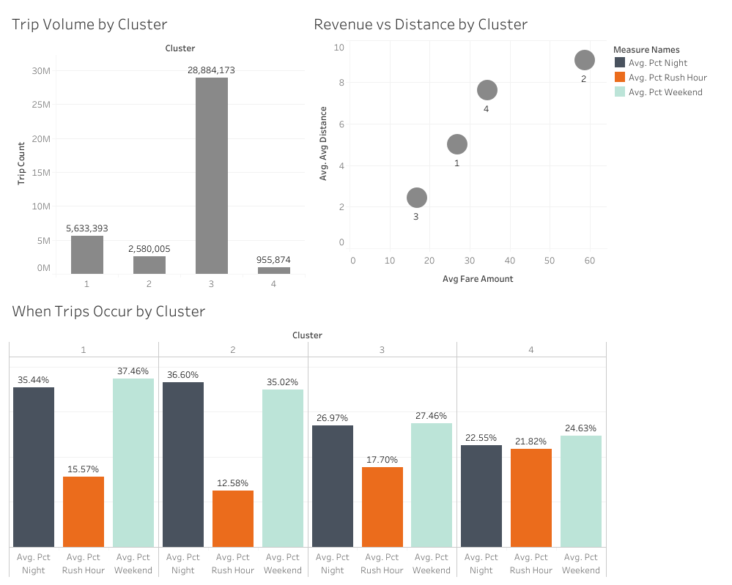
BigQuery ML: What We Learned
Clustering Results
Cluster 1: Nightlife & Weekend Zones
High night and weekend activity
Cluster 2: Strongest Nighttime Demand
Highest share of late-night trips with highest fares
Cluster 3: High-Demand Core Zones
Highest overall trip volume with lowest fares
Cluster 4: Commuter-Oriented Zones
Highest trip volume during rush hours
Business Value of Clustering
Target operations by zone type
Predict resource needs based on travel behavior
Weather had minimal impact on cluster formation, but it remained an important factor in day-to-day taxi demand and trip patterns.
Notes:
This dashboard helps us understand what each cluster represents from a business perspective.
Cluster 3 immediately stands out, accounting for nearly 29 million trips and serving as the primary demand center in our dataset. It also shows higher average fares and longer trip distances, highlighting its outsized impact on overall taxi demand and revenue.
Looking at trip timing, Clusters 1 and 2 show more nighttime and weekend activity, suggesting leisure-focused travel, while Cluster 4 has the strongest rush-hour patterns, indicating commuter behavior.
Together, these findings show that trip volume, fare levels, distance, and trip timing were the main drivers of cluster formation.
Weather did influence taxi demand and rider behavior at a more detailed level, which Maryam and Orlando will explore in the upcoming slides.

Slide 15
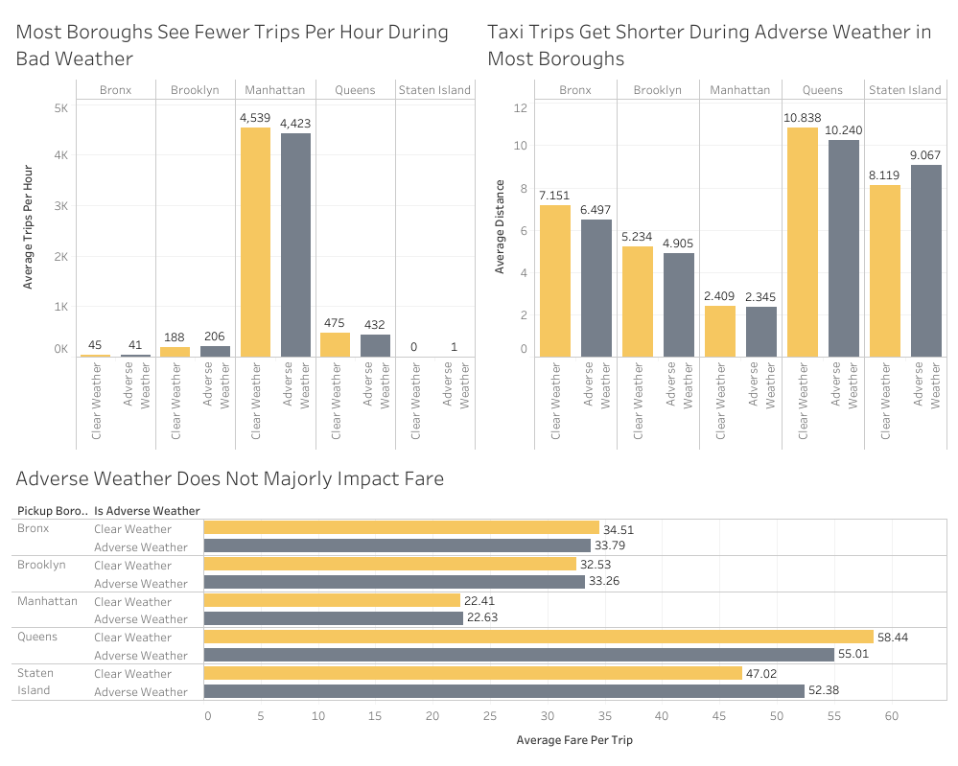
Tableau Dashboard
Testing
Point 1
Point 2
Point 3
Notes:
MARYAM: This Tableau dashboard gives us a high-level view of how adverse weather (rain and snow) affects taxi behavior across NYC's five boroughs.
[Top left chart – Trips per Hour] In the top left chart, we can see that most boroughs experience fewer trips per hour during adverse weather. Queens drops from 475 to 432 trips per hour, and The Bronx drops from 45 to 41. Manhattan, which dominates overall volume at over 4,500 trips per hour, still dips by about 100 trips per hour during bad weather.
[Top right chart – Distance] In the chart on the top right, we see that when people do take a taxi in bad weather, they're going shorter distances. This suggests that riders are using taxis for quicker, nearby trips rather than longer commutes.
[Bottom – Fare] The key insight from this dashboard is that despite fewer trips and shorter distances during adverse weather, the average fare per trip barely changes when compared to clear weather. For example, Manhattan averages $22.41 in clear weather versus $22.63 in adverse weather, which is nearly identical. This pattern holds across every borough.
So weather's impact is about volume, not price. To build on this, Orlando will walk through our Streamlit dashboard, which layers in the year-over-year comparison between 2025 and 2026, time of day, and specific weather types like rain versus snow to see what's driving these patterns.

Slide 16


Visualizations
How Does Adverse Weather Influence Taxi Demand, and Have Those Patterns Changed Over Time?
BigQuery ML Results
YoY Trip Analysis
Additional Analysis
Notes:
Tableau Speaker Notes
Transition into Tableau
For the Tableau portion, we focused on how taxi activity was distributed across the five boroughs plus EWR, how that distribution differed during adverse weather, and how those patterns changed from 2025 to 2026.
The Tableau views will be showing relative geographic shifts in trip activity, so we'll basically be looking at performance comparisons between the pickup areas.
1. Overall Taxi Volume by Pickup Area and Year
Main takeaway: Overall taxi volume was nearly flat year over year, but growth differed substantially by pickup area.
Across January through May, total trips increased only about 0.8%, from approximately 18.92 million in 2025 to 19.06 million in 2026.
However, that annual stability, some key area-level differences would be hidden. Brooklyn grew about 40%, from 571,000 to 797,000 trips, and the Bronx grew about 41%, from 134,000 to 188,000. Meanwhile, Manhattan remained by far the largest market but actually declined slightly, from 16.49 million to 16.36 million trips.
This gives us a baseline to keep in mind: the overall market was stable, but the geographic mix was already changing.
Transition: From there, we wanted to see whether that geographic mix also looked different during adverse weather.
And that brings us to our next visualization
2. Pickup Area Distribution of Trips by Weather
Main takeaway: Manhattan dominates taxi activity in every weather condition, but the geographic mix shifts slightly between adverse and non-adverse weather. Adverse weather here means rain and snow.
Each bar represents 100% of trips within that year and weather condition, and the colors show how those trips were distributed across pickup areas.
So, for example, if an area represents 1% of an adverse-weather bar as in the Bronx in 2026, that means 1% of all trips observed during that condition, of adverse weather, came from that area.
We kept this chart mainly as context because Manhattan's volume is so dominant that the smaller changes are difficult to see precisely here.
Transition: The next chart calculates those differences directly, so we can see which areas actually gained or lost relative share.
It shows
3. Pickup Area Share Shift During Adverse Weather
Main takeaway: The adverse-weather pattern changed noticeably from 2025 to 2026, particularly for Brooklyn and Manhattan.
This chart subtracts each pickup area's non-adverse share of trips from its adverse-weather share, leaving us with percentage point changes as our response variable to analyze.
Positive values on the right side of the zero axis mean the area represented a larger share of taxi activity during adverse weather; negative values mean a smaller share.
Looking at the left plot, we see that in 2025, Manhattan gained about +0.7 percentage points during adverse weather, while Queens declined about −0.8 points.
In 2026, that pattern shifted: Brooklyn increased from +0.2 to +0.8 points, while Manhattan flipped from +0.7 to −0.5 points. Queens remained negative but became somewhat less negative, moving from −0.8 to −0.4 points.
So the major year-over-year story is that adverse-weather activity became relatively more concentrated in Brooklyn and less concentrated in Manhattan in 2026.
Transition: Here we are seeing that the annual values summarize the overall pattern, but the monthly views we're looking at next show that these effects were not consistent throughout the year.
This visualization is showing
4. Monthly Weather Share Shift
Main takeaway: The weather-related geographic shift varied significantly month to month, with some of the strongest changes occurring in 2026.
This heatmap uses the same share-shift calculation, but calculates it separately for each month.
A few examples show why the monthly detail matters.
In early 2026, Brooklyn consistently gained share during adverse weather — approximately +1.1 points in January and +1.7 in February.
At the same time, Manhattan moved in the opposite direction, falling about −1.2 points in January and −3.0 points in February.
But the pattern later reversed: Manhattan gained about +1.8 points in April and +1.5 in May, while Queens fell approximately −2.2 and −1.4 points in those same months.
So the impact of adverse weather was not uniform across either location or time. The annual results are really the combination of several different monthly patterns.
Tableau Story / Conclusion
The monthly view shows that these shifts weren’t consistent throughout the year, but the broader pattern is still clear: overall taxi volume stayed relatively stable, while adverse weather was associated with changes in where that activity was concentrated.
The biggest year-over-year change was between Brooklyn and Manhattan. Brooklyn became more prominent during adverse weather in 2026, while Manhattan shifted from gaining share in 2025 to losing share in 2026.
Overall, the takeaway is that adverse weather does not affect every pickup area the same way, and those geographic patterns changed meaningfully between 2025 and 2026.

Slide 17
Summary and Recommendation
When It Rains, Get to Brooklyn
The Data
Brooklyn demand surges +27% during rain (188 → 238 trips/hr)
Per-minute earnings rise +11% ($1.14 → $1.26/min)
Why It Matters
Brooklyn is the only borough where both volume and earnings efficiency increase during rain
When It Snows, Stay on the Road
The Data
Earnings per active minute rise in every borough during snow (+8% to +29%)
Manhattan: $1.52/min clear → $1.64/min snow (+8%)
Why It Matters
Drivers who remain available during snow face less competition and earn more per minute of driving time
Clear Weather: Manhattan or Queens
Manhattan: Volume
4,539 trips/hr, $1.52/min earnings
Minimal idle time between fares
Queens: Efficiency
$58 avg fare, $1.73/min earnings (+14% over Manhattan)
Longer trips with higher per-minute return
Why It Matters
94.5% of hours are clear. Manhattan guarantees volume; Queens rewards drivers who stay busy with airport and cross-borough runs.
Each weather condition calls for a different positioning strategy. Rain is an opportunity, snow rewards persistence, and clear weather is about volume consistency.
Notes:
ORLANDO: So what should taxi drivers actually do with this information? Our data supports three clear recommendations. First, when it rains, get to Brooklyn. Brooklyn is the only borough where both demand and earnings efficiency increase during rain. Demand surges 27 percent, from 188 to 238 trips per hour, and per-minute earnings rise 11 percent, from $1.14 to $1.26 per active minute. No other borough shows that combination. Second, when it snows, stay on the road. This might sound counterintuitive because total trip volume drops during snow. But the drivers who remain available earn more per active minute of driving, in every single borough, ranging from 8 percent more in Manhattan to 29 percent more in the Bronx. In Manhattan, that's $1.52 per minute during clear weather rising to $1.64 during snow. Fewer drivers on the road means less competition for the fares that are still available. Third, during clear weather, which accounts for 94.5 percent of all operating hours, drivers have two strong options. Manhattan offers unmatched volume at over 4,500 trips per hour, meaning minimal idle time between fares, at $1.52 per active minute. Queens offers a 14 percent earnings premium at $1.73 per active minute, driven by longer trips averaging $58 per fare. For drivers who can stay busy in Queens, particularly with airport runs, the per-minute return is higher. All of these figures exclude tips to avoid the cash tip recording bias in the data. They represent fare revenue earned per minute of active driving time. The bottom line is that each weather condition calls for a different strategy. Rain is an opportunity, snow rewards those who stay, and clear weather is about choosing between volume consistency in Manhattan or higher per-trip efficiency in Queens.

Slide 18
4
Future State
Notes:
Now, our future state proposal

Slide 19
Future State Proposal
Real-Time Ingestion
What We Would Do
Stream trip and weather data continuously
Business Benefit
Near real-time visibility into demand during storms
ML Forecasting
What We Would Do
Predict demand changes before weather events occur
Business Benefit
Improve driver positioning and reduce idle time
Expanded Analysis
What We Would Do
Extend to full-year data for seasonal patterns
Incorporate Uber/Lyft to compare surge pricing during storms
Business Benefit
Reveal how demand shifts across all seasons and how rideshare surge pricing competes with taxis
Highest Impact: Real-Time Ingestion. Fleet operators need minute-level demand signals during active storms.
Notes:
We identified three potential next steps to build on this solution. First, real-time ingestion would allow trip and weather data to flow continuously, giving operators a more up-to-date view of demand during storms. Second, machine learning forecasting could help predict demand changes before storms occur, enabling more proactive planning. Third, we would expand the analysis itself. Our current dataset covers January through May, so we're missing summer and fall seasonality. A full year of data would show how these patterns hold across all seasons. We'd also incorporate rideshare data from Uber and Lyft to understand how surge pricing during storms competes with traditional taxi demand. Our top recommendation is real-time ingestion because it offers the greatest business value with the lowest implementation effort.

Slide 20
Thank You
Questions?
Notes:
Thank you for your time and attention today.
We appreciate the opportunity to share our findings and would be happy to answer any questions.

Slide 21
AI Use Disclosure
Where We Used AI
Pipeline development and SQL transformations
Streamlit visualizations and chart logic
Data analysis and revenue calculations
Presentation content and speaker notes
How We Verified
Ran full pipeline end-to-end and reconciled row counts against source
Cross-checked all calculations against raw data and Tableau results
Reviewed and revised all generated content before committing
Every number on every slide traces back to a verifiable query
What We Corrected
Fare calculations initially included tips, inflating averages. Caught and corrected.
Hourly earnings used an unverifiable utilization assumption. Replaced with $/active-minute.
Initial summary slide was descriptive. Reworked to be prescriptive with data-backed actions.
AI accelerated development. Human judgment drove every analytical decision and verified every output.

